Slide 1

Spatiotemporal Epidemiology of COVID-19 in the contiguous us
By Mohsen Ahmadkhani

Slide 2
Data
COVID-19 daily data by New York Times for the US
MOD11A1.006 Terra Land Surface Temperature and Emissivity Daily Global 1km
US county level boundaries and population by the US census bureau

Slide 3
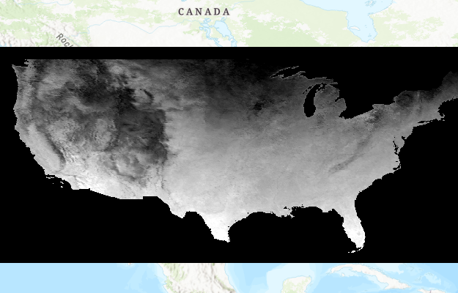
Data: Modis

Slide 4
Technologies Used
Google Earth Engine
PostgreSQL
SaTScan
ArcGIS Pro
Python (Requests, Seaborn, Scipy, Whitebox, Rasterio, Rasterstats, Geopandas, Arcpy, etc.)

Slide 5
methods
Global Moran’s I
Local Moran’s I
Pearson, Spearman, and Kendall Correlation
Retrospective Space-Time Permutation Scan Statistics Analysis

Slide 6
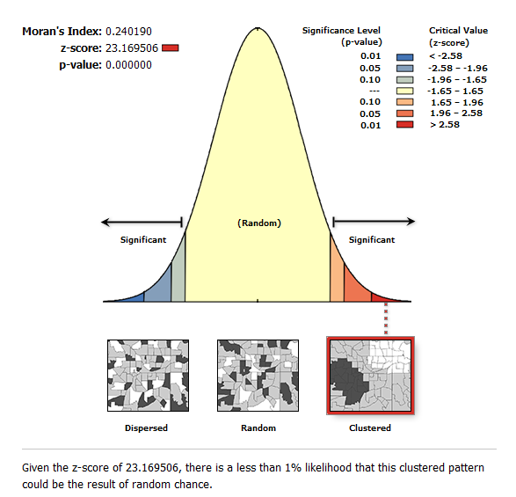
Results: Spatial Autocorrelation

Slide 7
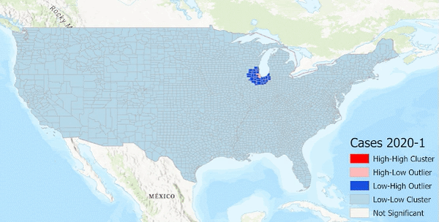
Results: Local moran’s i

Slide 8
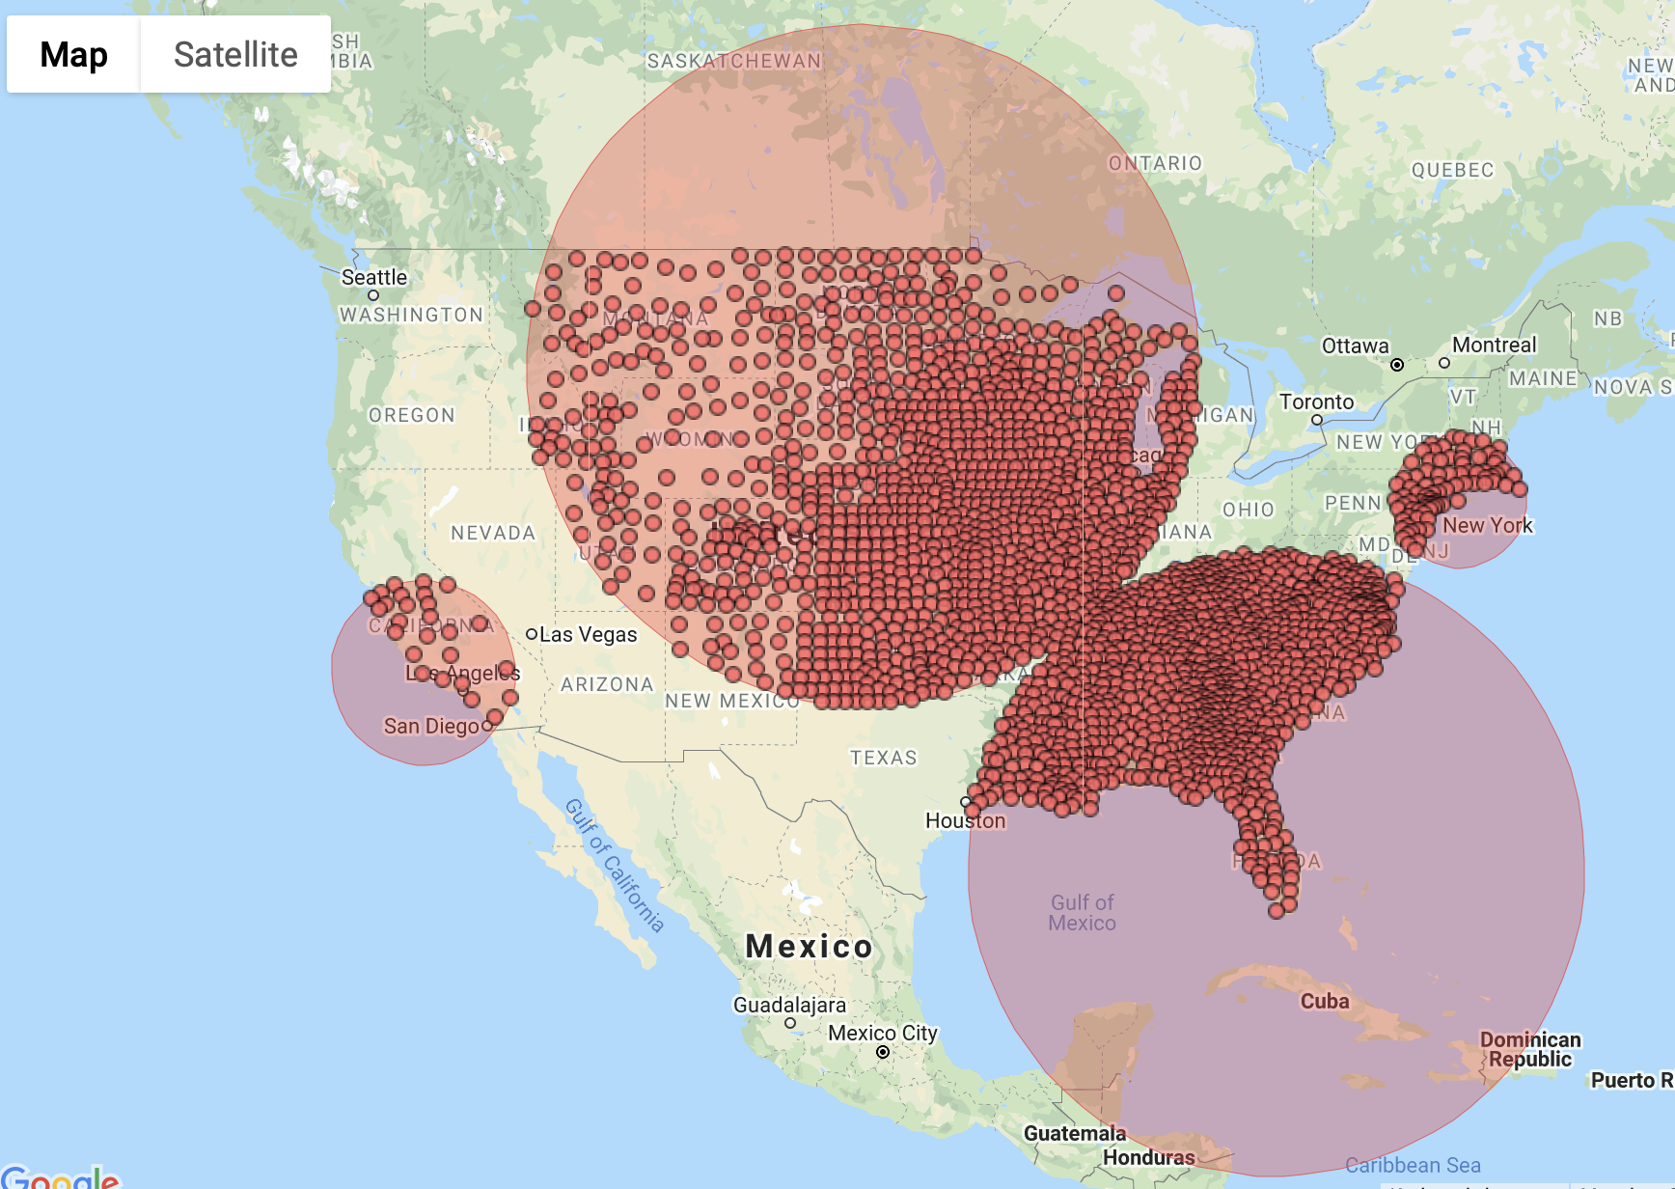
Results: COVID-19 monthly cases
Cluster 1
Cluster 2
Retrospective Space-Time analysis
scanning for clusters with high rates
using the Space-Time Permutation model.
Cluster 4
Cluster 3

Slide 9
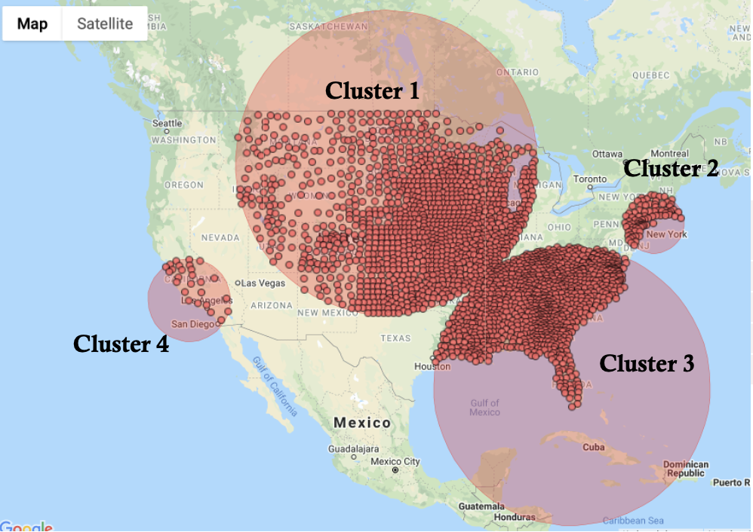
Results: COVID-19 monthly cases
 | Time frame | Observed cases | Expected cases | Observed / expected | P-value
Cluster 1 | 2020/9/1 to 2020/11/30 | 5356478 | 3126761.75 | 1.71 | < 0.00000000000000001
Cluster 2 | 2020/3/1 to 2020/5/31 | 1029438 | 287905.91 | 3.58 | < 0.00000000000000001
Cluster 3 | 2021/7/1 to 2021/9/30 | 7670932 | 5399172.92 | 1.42 | < 0.00000000000000001
Cluster 4 | 2020/12/1 to 2021/1/31 | 3746272 | 2289879.49 | 1.64 | < 0.00000000000000001

Slide 10
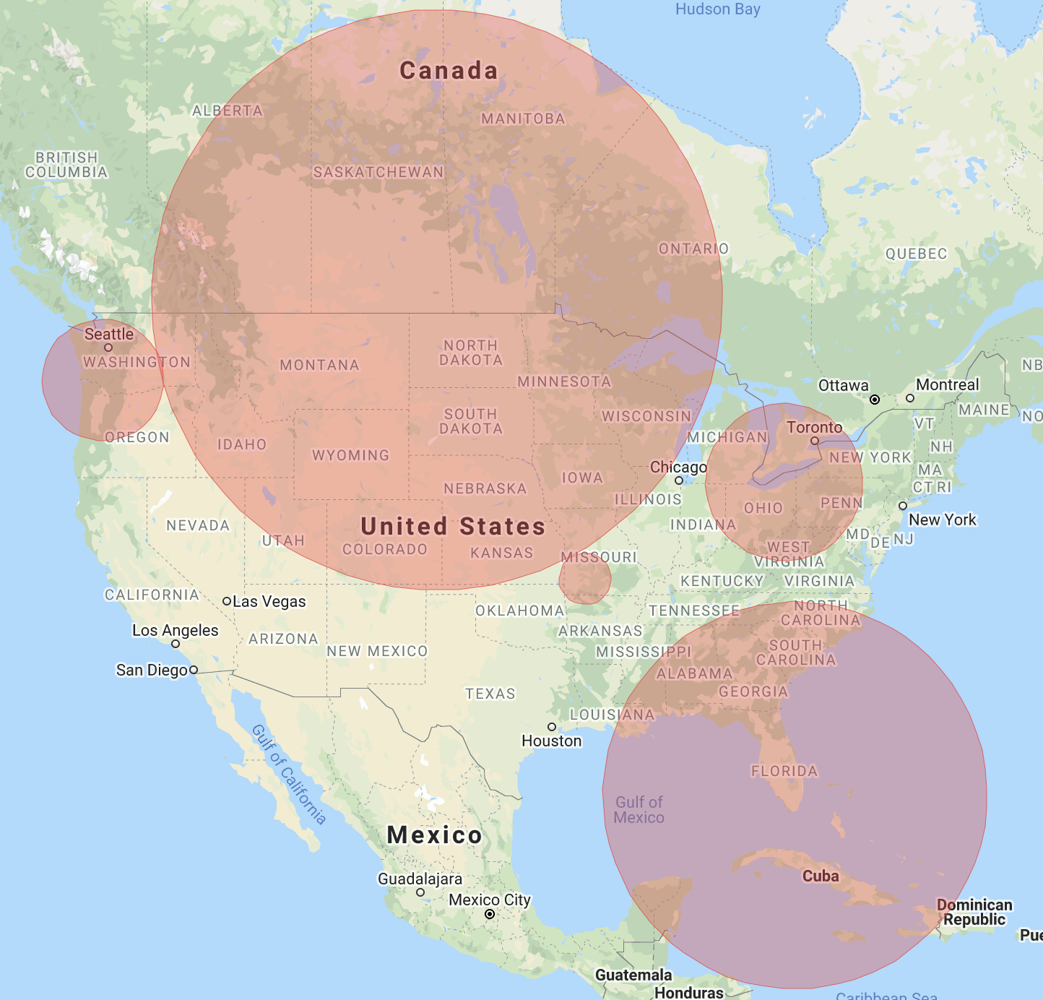
Results: HH&HL Cluster occurrence frequency
Cluster 3
Cluster 4
Cluster 1
Retrospective Space-Time analysis
scanning for clusters with high rates
using the Space-Time Permutation model.
Cluster 5
Cluster 2

Slide 11
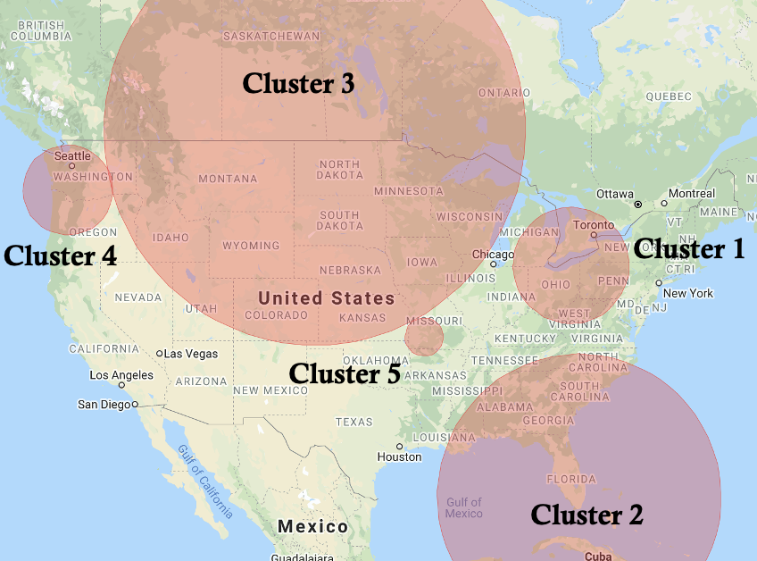
Results: HH&HL Cluster occurrence frequency
 | Time frame | Observed cases | Expected cases | Observed / expected | P-value
Cluster 1 | 2021/10/1 to 2021/11/30 | 1287 | 498.08 | 2.58 | < 0.00000000000000001
Cluster 2 | 2021/7/1 to 2021/9/30 | 1247 | 603.43 | 2.07 | < 0.00000000000000001
Cluster 3 | 2020/9/1 to 2020/11/30 | 1314 | 750.95 | 1.75 | < 0.00000000000000001
Cluster 4 | 2021/5/1 to 2021/6/30 | 255 | 64.09 | 3.98 | < 0.00000000000000001
Cluster 5 | 2021/6/1 to 2021/6/30 | 74 | 9.86 | 7.51 | < 0.00000000000000001

Slide 12
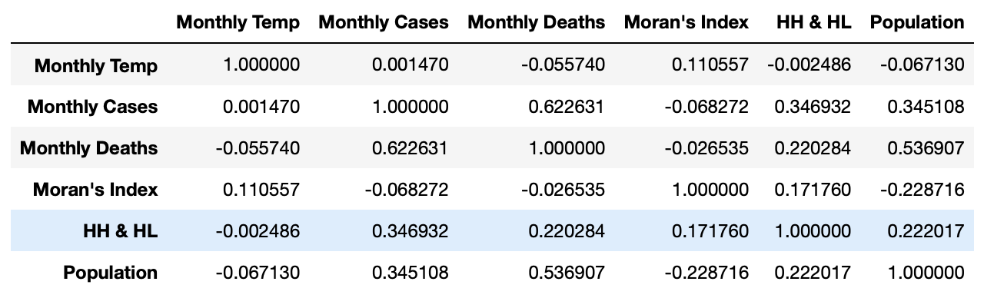
Results: Correlation analysis

Slide 13
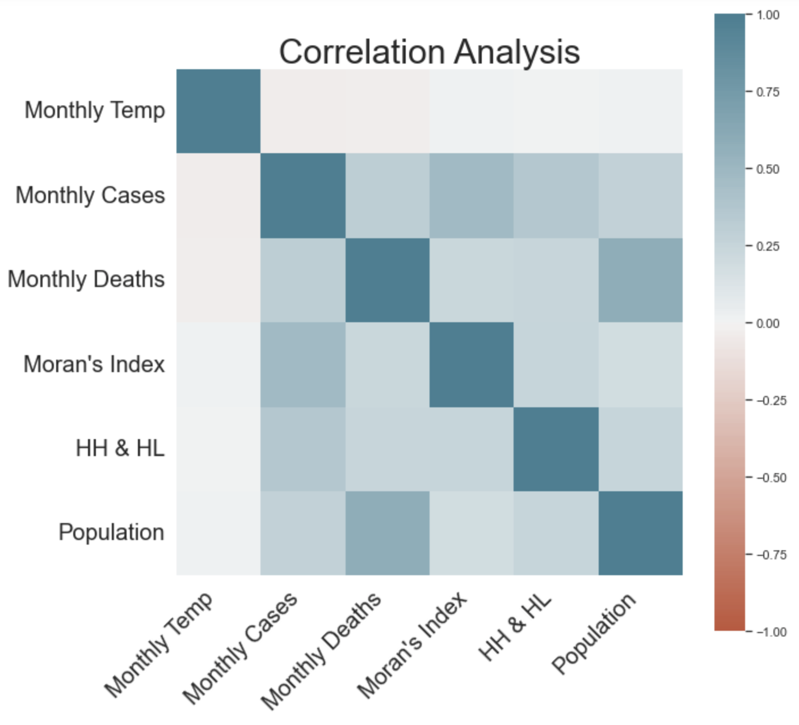
Results: Correlation analysis

Slide 14
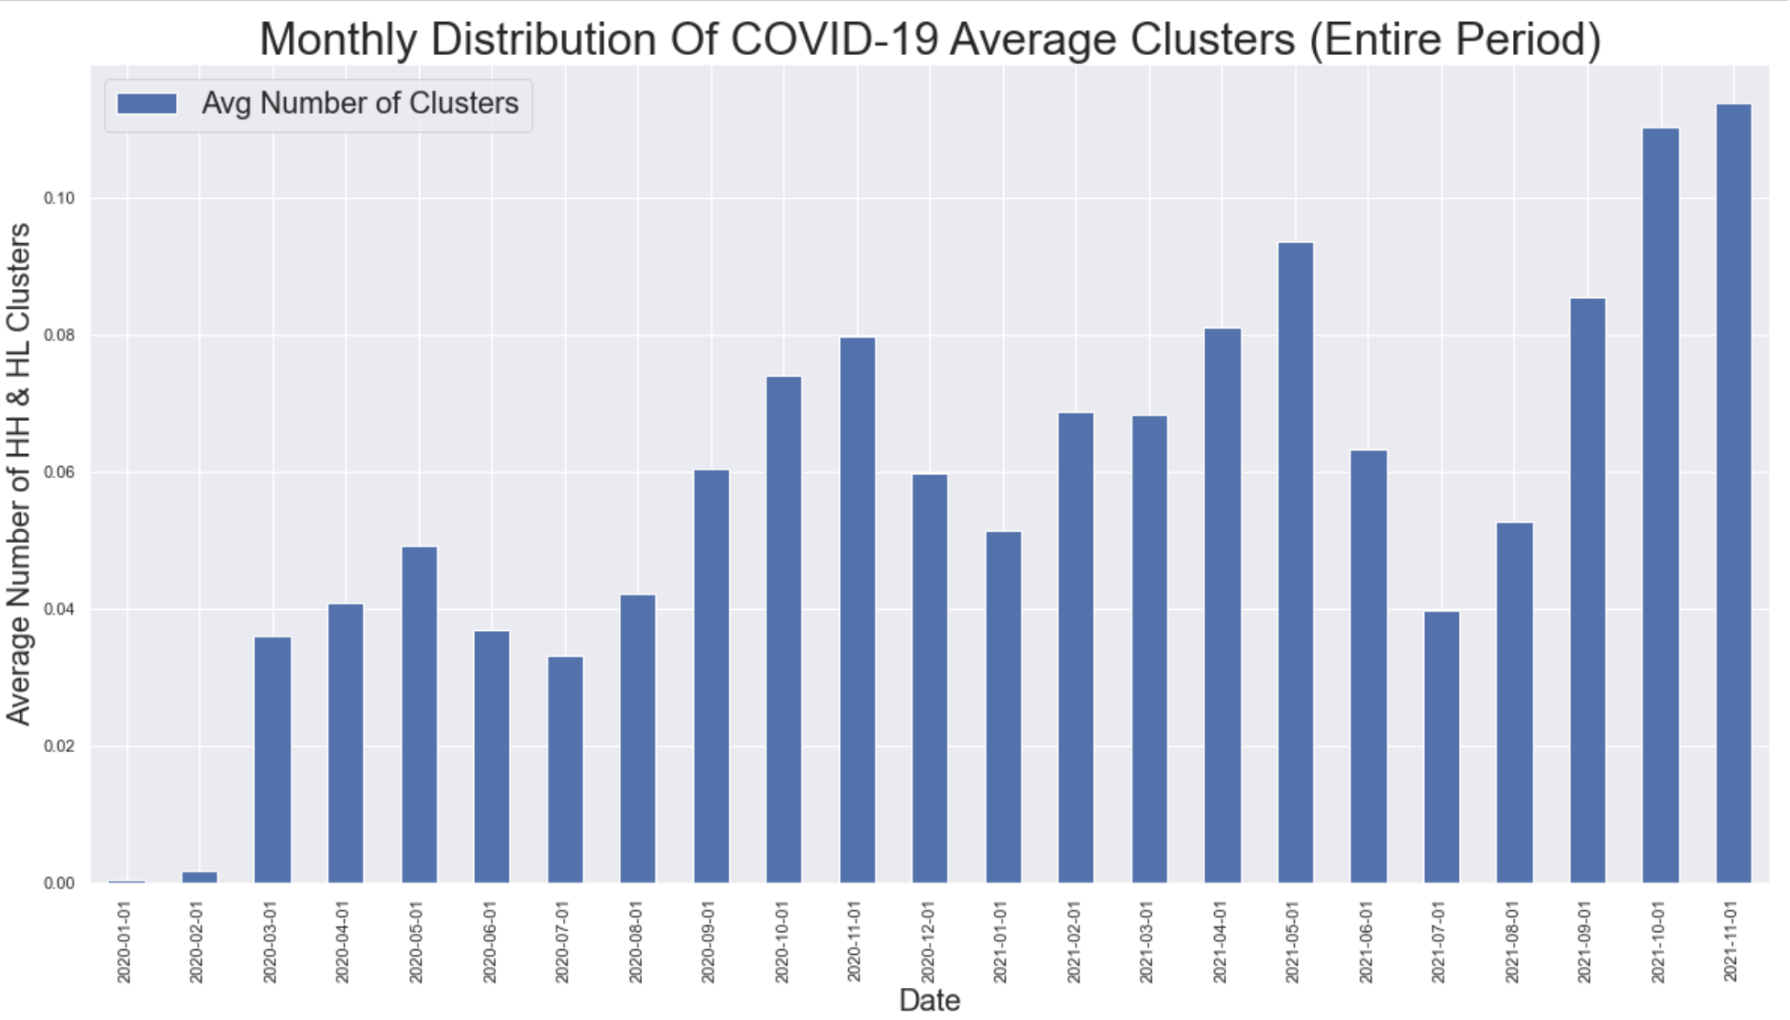
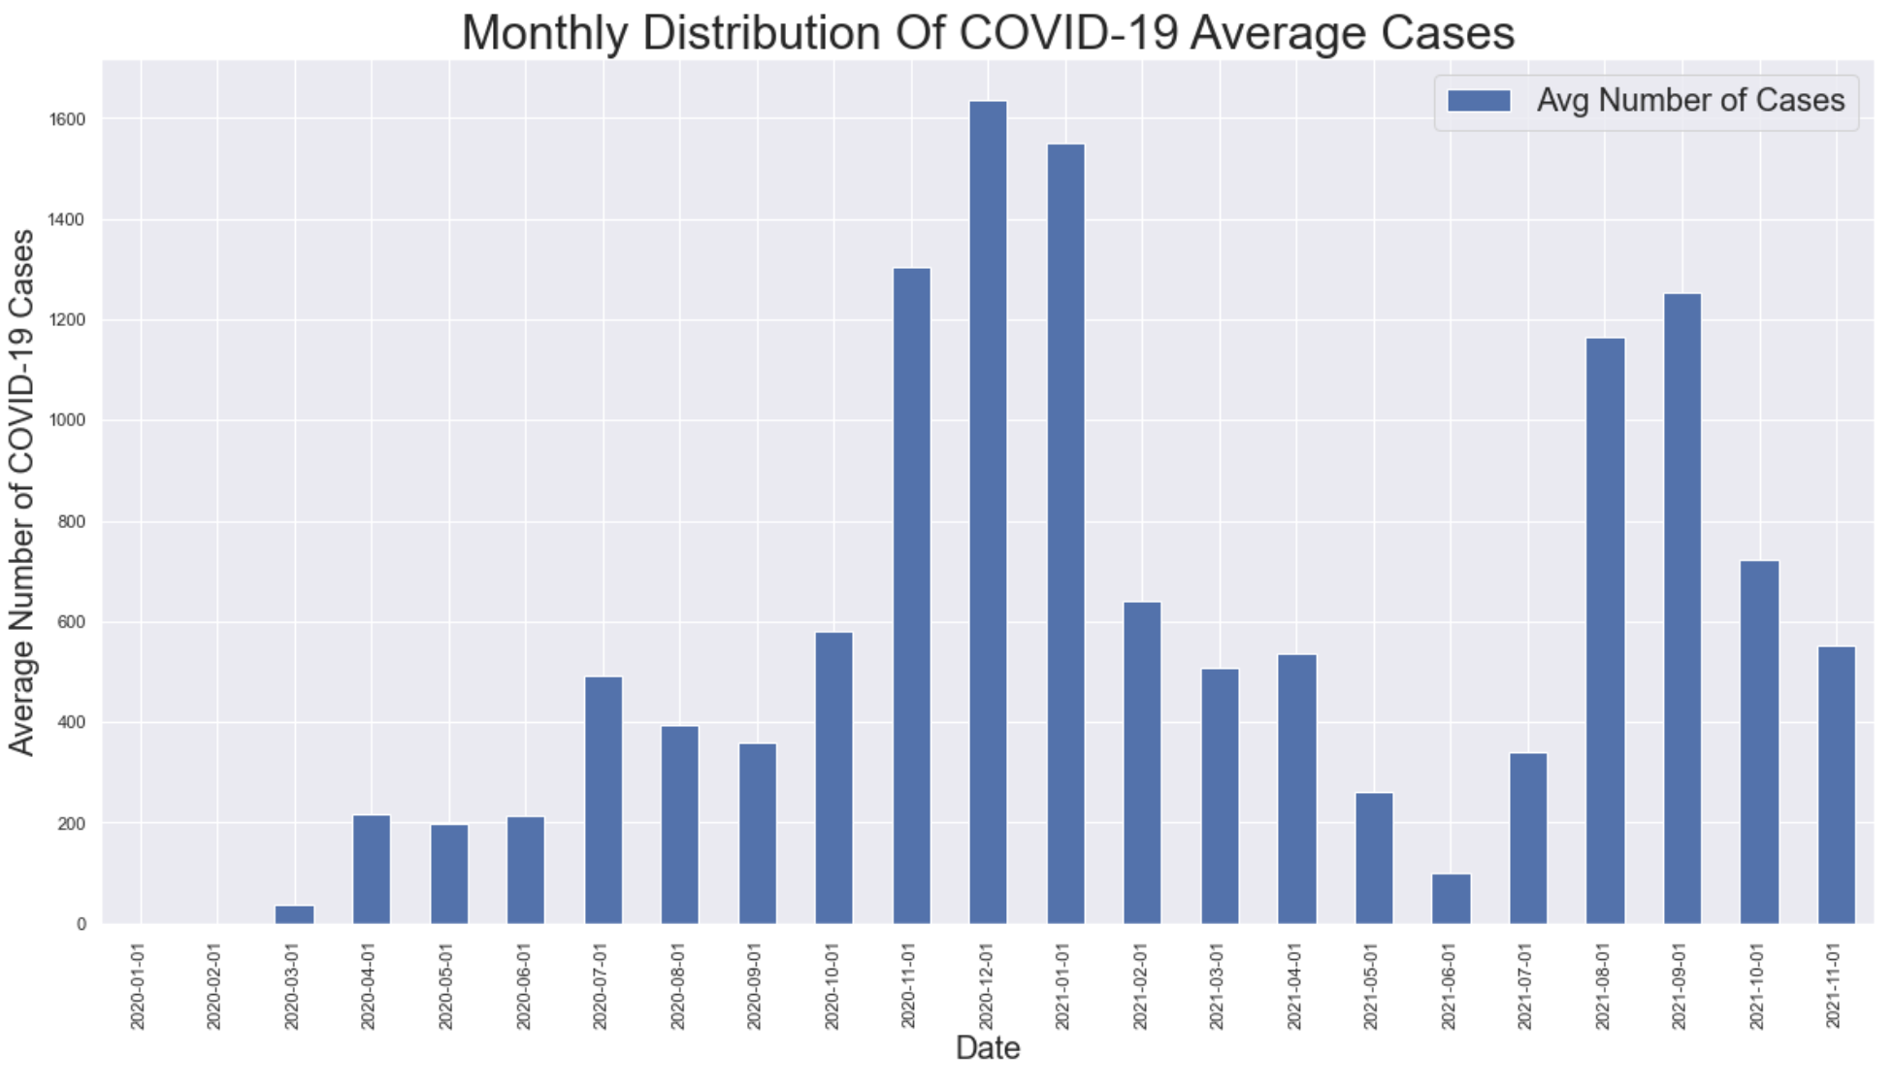
Results: Temporal analysis (entire period)

Slide 15
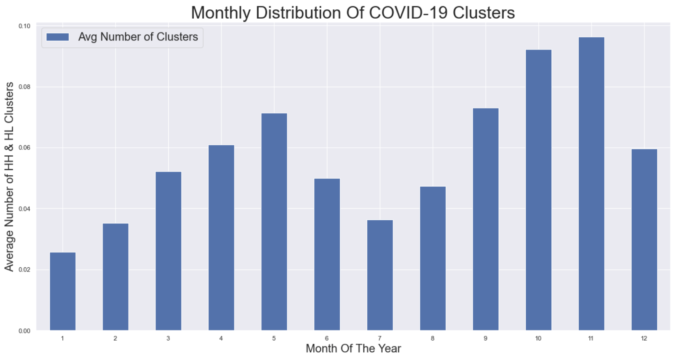
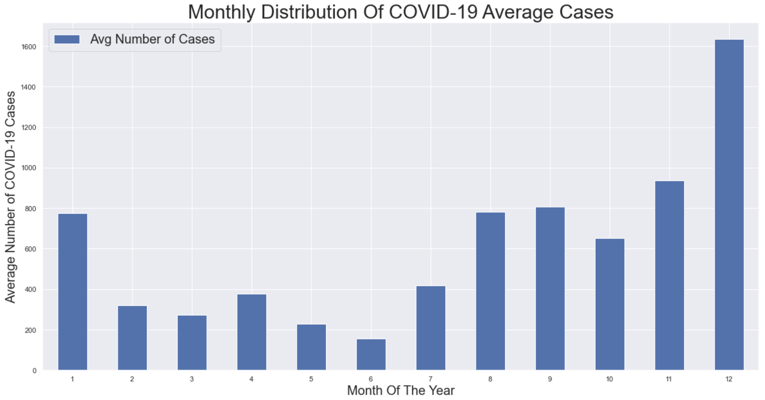
Results: Temporal analysis (yearly)

Slide 16
Discussion & Conclusion
There is not a significant explicit correlation between monthly covid cases/clusters and monthly aggregated temperature
There are many contributing factors like political and social events, precautionary policies, public behaviors, and many other environmental factors.
The Midwest area has been a disease cluster in the election period.
Ohio, Michigan, Indiana and Pennsylvania have been disease cluster in the election period.
Currently, there is no ongoing disease significant spatiotemporal cluster in the US.

Slide 17
Thank you!

